Slide 1

Multitenancy on Oracle Cloud Infrastructure
Raoul Miller, Ph.D.
Director, Solutions Architecture
Oracle for Research

Slide 2
Overview
There are different aspects of multitenancy in the cloud:
How OCI manages multitenancy on the hardware for our customers
How customers manage multitenancy within their OCI accounts
How customers manage design and deployment of multi-tenant solutions on OCI

Slide 3
What is Multitenancy?
“In cloud computing, multitenancy means that multiple customers of a cloud vendor are using the same computing resources. Despite the fact that they share resources, cloud customers are not aware of each other, and their data is kept totally separate.
Multitenancy is a crucial component of cloud computing; without it, cloud services would be far less practical. Multitenant architecture is a feature in many types of public cloud computing, including IaaS, PaaS, SaaS, containers, and serverless computing.”
https://www.cloudflare.com/learning/cloud/what-is-multitenancy/

Slide 4
Some “Cloud Killers”
Security failures resulting in cross tenancy access
Failures to multi-tenant systems isolation, resulting in cross tenancy data exposure
Irrevocable loss of customer data
These apply to all aspects of multitenancy – not just hosting

Slide 5
Basics of cloud architecture
A lot of the “how?” is internal confidential info for each of the hyperscale cloud vendors
Key considerations are:
Share hardware
Separate everything else – data, compute, traffic
Inadvertent crossing of account boundaries is unacceptable
Compute
Data
Networking
Security
Services
SaaS

Slide 6
Organization Management on OCI
These are the use cases that we see at Oracle for Research
Important to understand how the different levels in the hierarchy work

Slide 7
Hierarchy of Environments
Plan
Contractual agreement with an organization
Tenancy
One or more tenancies created on OCI under that contract
Sub (Child) tenancy
Compartment
Sub compartment
Plan (contract)
Tenancy A (Parent)
Tenancy B (Child)
Tenancy C (Child)
Compartment A
Compartment B
Compartment C
Sub Compartment D
Sub Compartment E

Slide 8
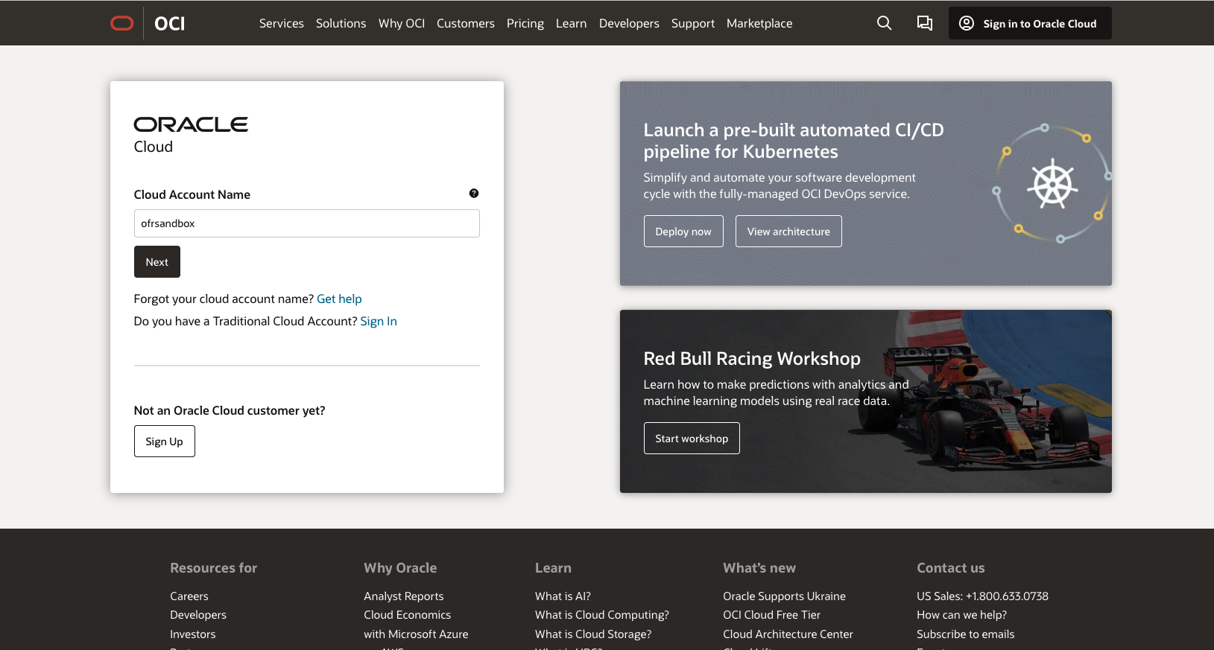









Tenancy
This is my tenancy name

Slide 9
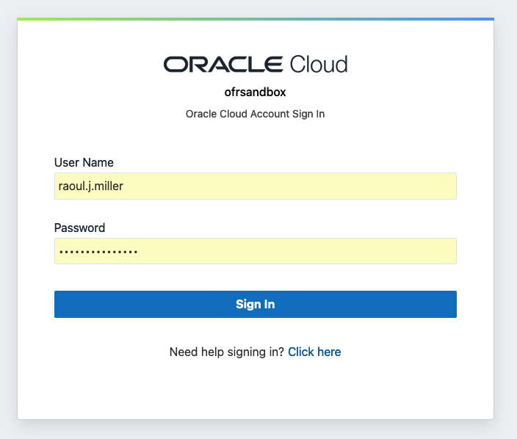


User Identity within a Tenancy
User Identity and authentication is tied to an individual tenancy (although federation with identity providers is common)
Authorization is also tenancy specific

Slide 10
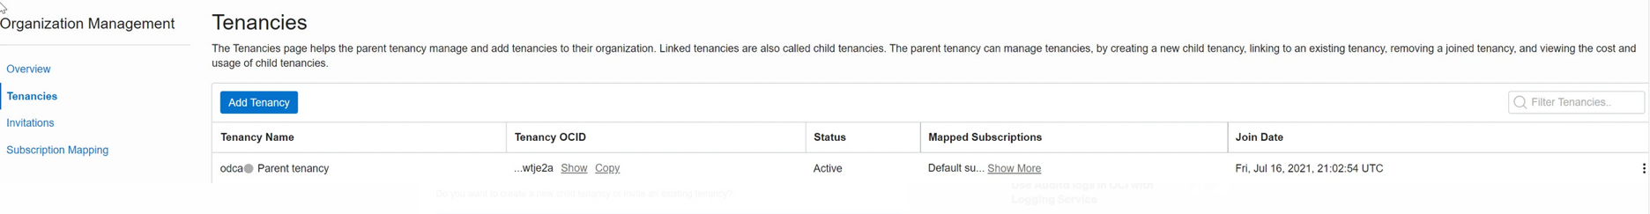
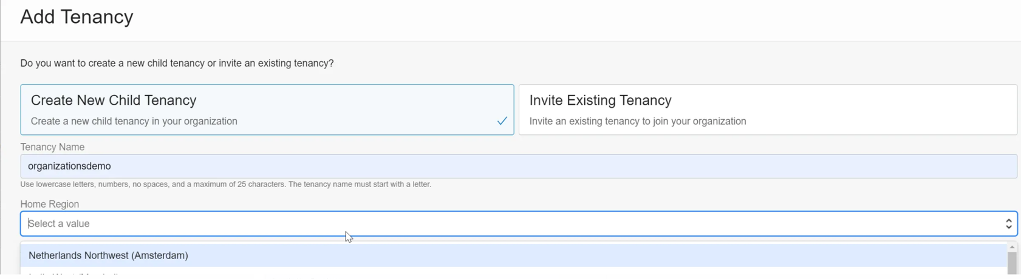
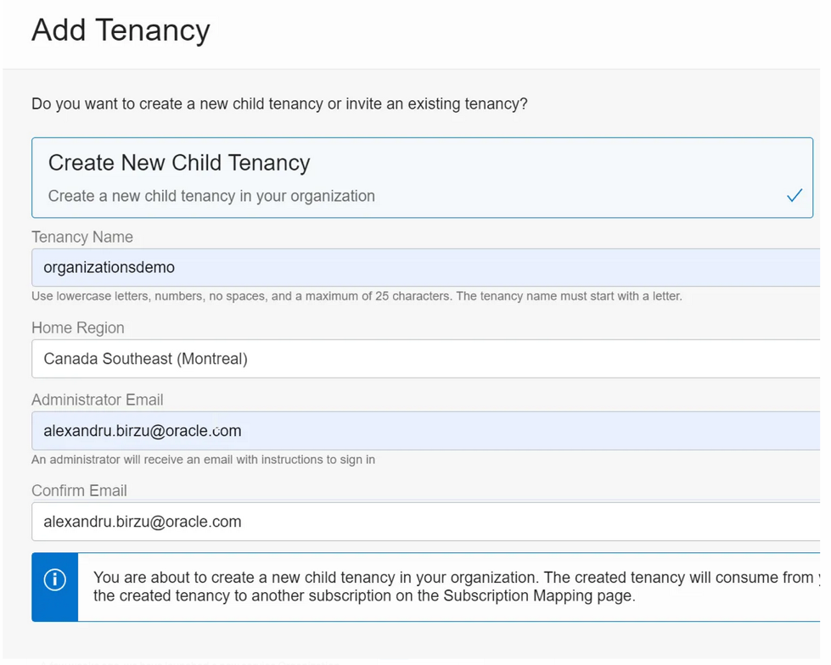


Sub or Child Tenancies

Slide 11
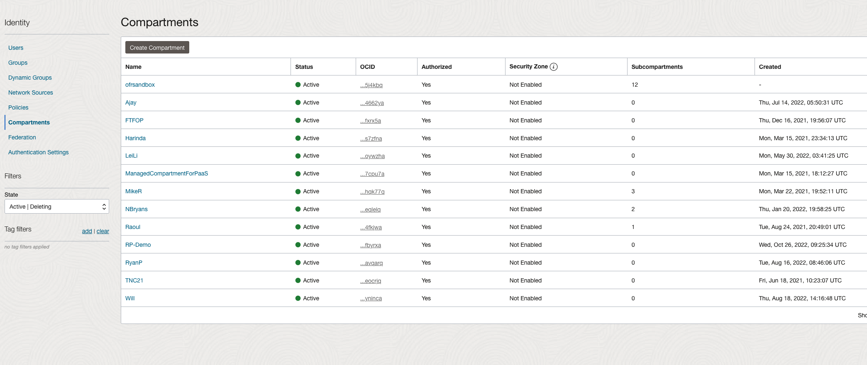
Compartments

Slide 12
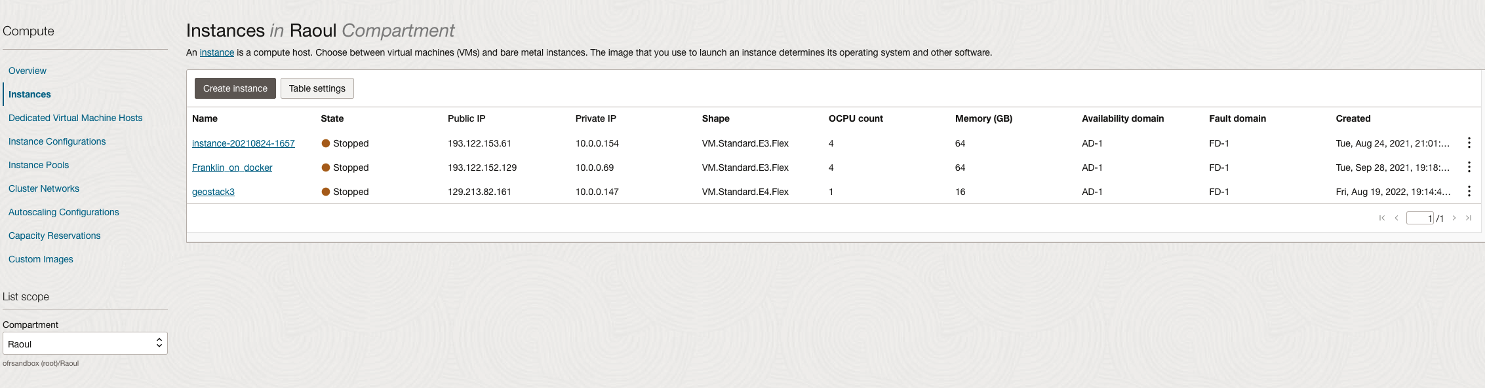
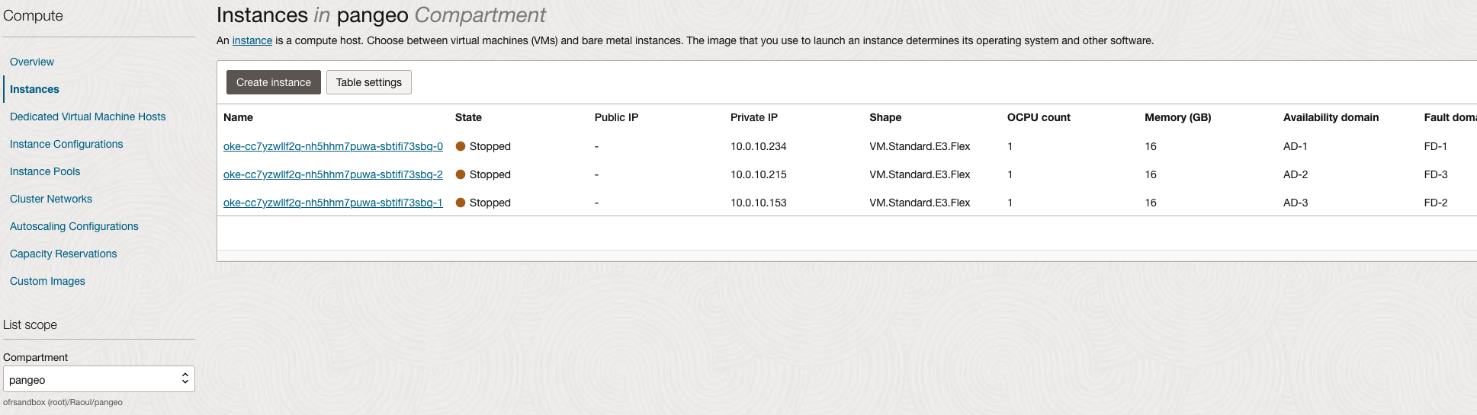





Sub Compartments

Slide 13
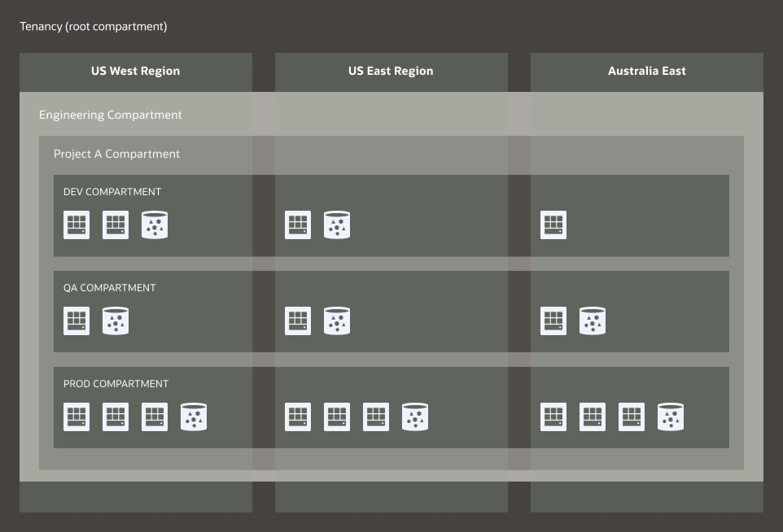
Tenancy / Compartment / Region
Data can be replicated across regions, but resources are created in one
(although they can be replicated / created in others)

Slide 14
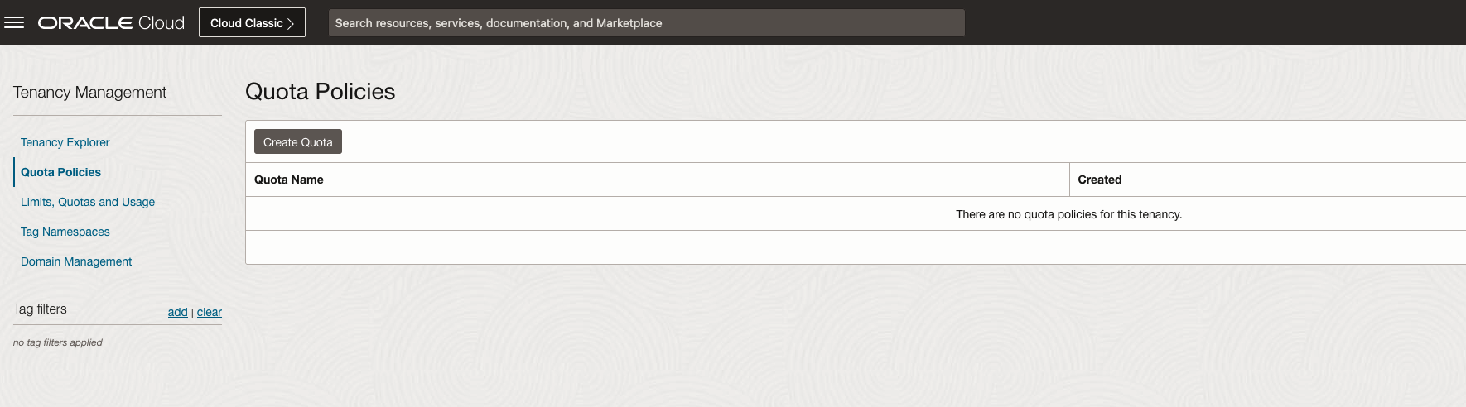
Managing Multitenancy within an Organization
Tagging
Tagging of resources and service can be very helpful for cost control
You can configure tags to inherit from compartments
Tags can be freeform or pre-defined
Tenancy management
Apply quota policies to compartments
Use groups and security policies within tenancies to manage access in more detail

Slide 15
Deploying Multitenant Applications on OCI
This is relatively rare within our research customer base
But many of the same considerations apply

Slide 16
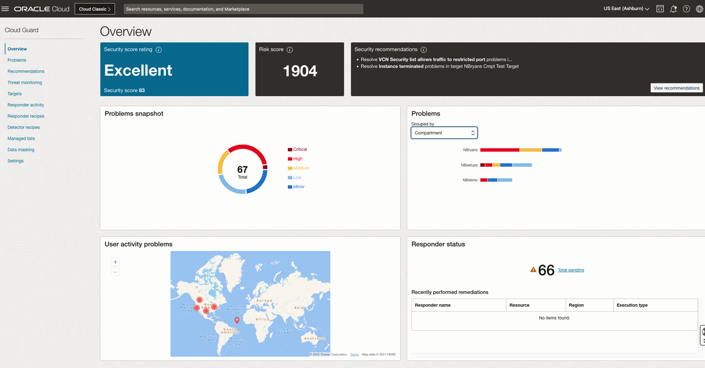



Workload Considerations
“Noisy Neighbor”
One of great challenges in cloud
OCI has VNICs that segment “work” traffic from infrastructure traffic
Use shapes with RDMA
Where is the data?
Always locate data close to compute
10TB of outbound data transfer free / month
Monitoring
Use Cloud Guard to monitor

Slide 17
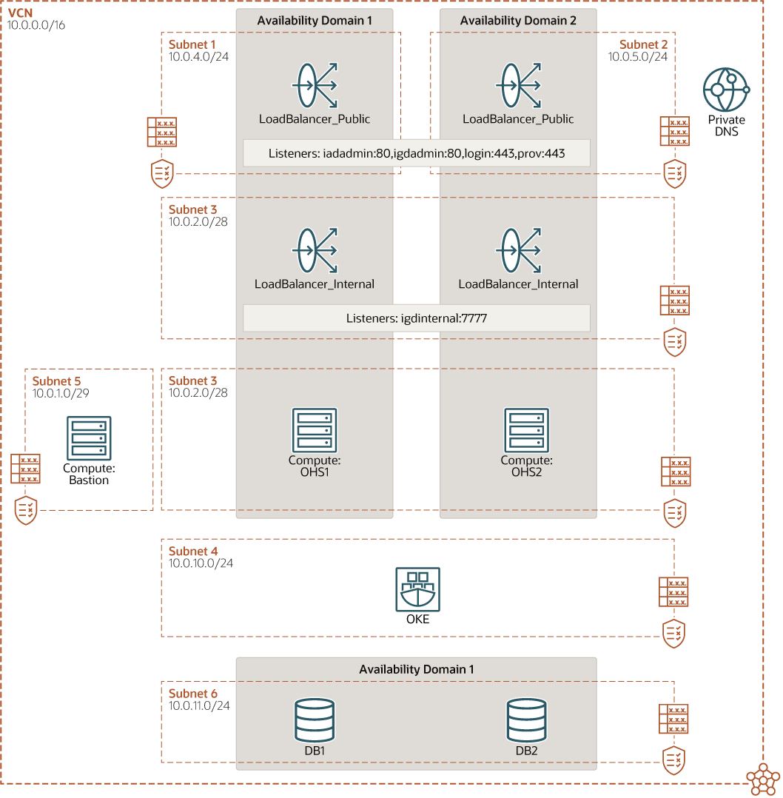
Hosting Multitenant Applications on OCI (e.g.: deployment on Kubernetes)
Use RBAC Authorizer for additional fine-grained access
Use namespaces if multiple clusters are not an option
Use a namespace naming convention to ease deployment across multiple environments
Isolate workloads in dedicated node pools
Enforce resource quotas
Autoscale worker nodes and pods
Use a flexible load balancer

Slide 18


Oracle for Research: Overview
Oracle for Research is Oracle’s global organization that is focused exclusively on supporting scientific research.
We exist to simplify the research process and accelerate discovery around humanity’s most urgent needs.
Oracle for Research offers products, capabilities, and resources purpose-built for research.
We support scientific research through grants, programs, cloud technology, and hands-on expertise.
Researchers in academic, commercial, and federal settings are achieving ground-breaking results with Oracle.

Slide 19

Oracle for Research platforms and channels
Blog & Website
Check out the Oracle for Research website & blog, and revisit them periodically for updates.
Social
Follow us on social over at @OracleResearch and via the #OracleResearch hashtag.
Podcast
Listen on Spotify or search “Research in Action” in your favorite podcasting app.

